Slide 1


Development of a secure Python Application
Student name: Savu Sever-Alexandru​
Student code: 2119586
Course: DEV6003 Secure Application Development
Tutor: Konstantinos Fouzas

Slide 2
Introduction
Software used: Visual Studio 2019, MySQL Server, MySQL Workbench, Oracle Virtualbox, Ubuntu, Sonarqube, Jenkins, Github
Application required 3 specs:
A database
An authentication mechanism
An access control mechanism

Slide 3
Installed Software
In order to prepare the code analysis, I took the following 3 steps.
Preparing an Ubuntu virtual machine using Oracle Virtual Box
Installing SonarQube and all the required dependencies such as Java, Git, and others
Installing Jenkins and configuring SonarQube to obtain code from Jenkins and analyze it

Slide 4
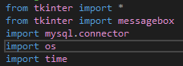
Writing the code - 1
Installed MySQL Server and MySQL Workbench in order to create the database and visually work with it using Workbench
Installed Visual Studio 2019 and created a Python project
Installed the Tkinter module through Visual Studio to make the GUI
Installed the MySQL connector
In the code, I import the required modules and then begin writing the actual app

Slide 5
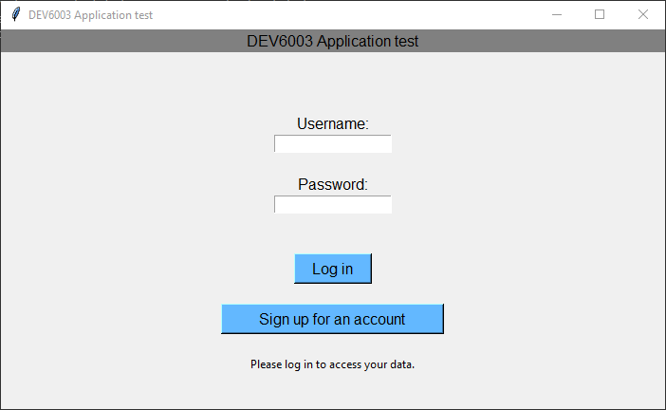
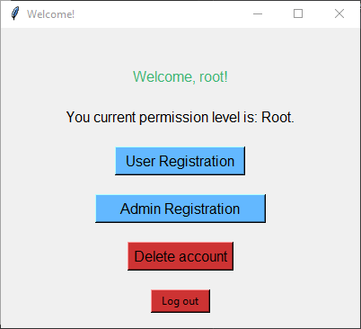
Function of the app
Simple main menu with 2 options: Logging in and signing up for an account.
Upon logging in, the app checks the “power” of the user from 3 levels:
Normal user
Administrator
Super user (root)
Each power level has different permissions:
Normal users can log out or delete only their account
Admins can delete accounts of normal users, create users, and log out
Root can create administrators, normal users, and delete either of them.
The root user cannot be deleted.

Slide 6
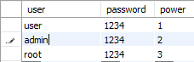
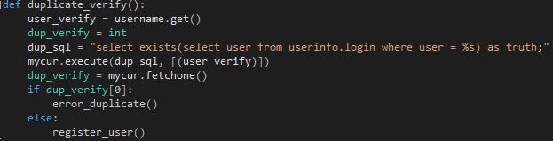
Function of the app – More info
The app connects to an SQL database where the user information is stored
As shown in the image, power level 1 is for normal users, 2 is for administrators, and 3 is for super users.
When registering users, a short duplicate verification is done to ensure the app doesn’t crash due to SQL refusing to add a user with an already existing name in the table.

Slide 7
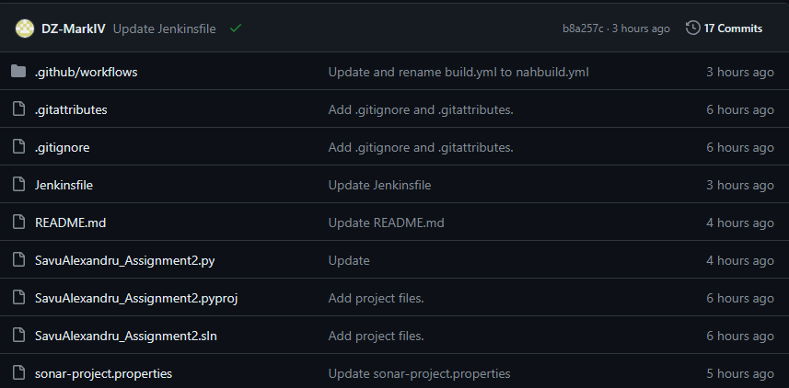
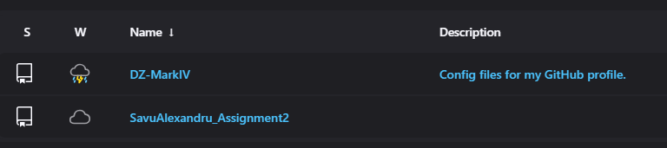
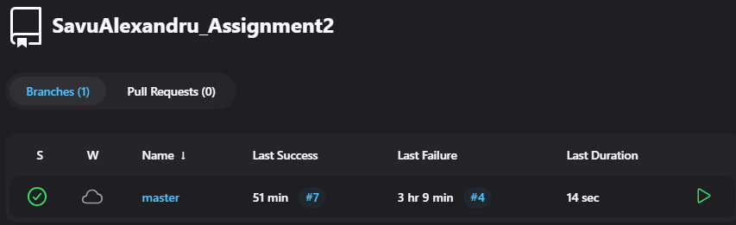
Preparing the code for analysis
In order to analyze the code, I pushed it to the github repository you found this presentation in, allowing Jenkins to import it for analysis.

Slide 8
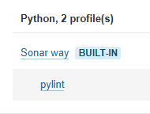
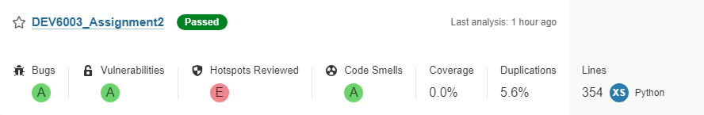
SonarQube analysis 1
Upon successful importation of the Github repository from Jenkins, SonarQube performs analysis using a built in quality profile with additional rules enabled.
For this particular app, SonarQube shows that it has 1 security problem, but no bugs or vulnerabilities

Slide 9
SonarQube analysis 2
The detected vulnerability is that the database connection is using hard-coded credentials.
This is a cause of concern because it’s easy to extract strings from source code or binaries, especially for open source apps such as this one.

Slide 10
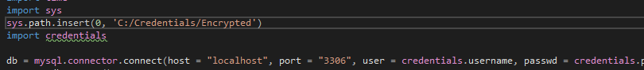
SonarQube analysis 3
The detected vulnerability is that the database connection is using hard-coded credentials.
This is a cause of concern because it’s easy to extract strings from source code or binaries, especially for open source apps such as this one.
Fixed by moving the credentials to an encrypted, separate location.

Slide 11
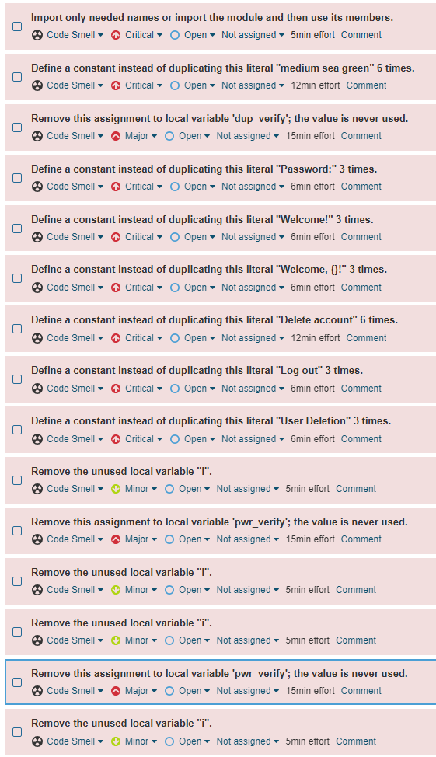
SonarQube analysis
The program also had several false positives, flagging duplications of displayed text in the GUI.
Additionally, it flagged some variables such as “i” and “pwr_verify” as never used, despited both of them being used in multiple locations.
These errors were marked as false positives in the software and removed.

Slide 12
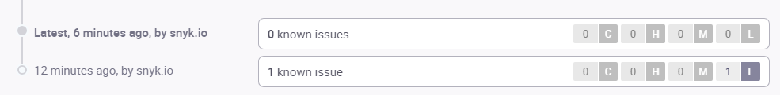
Additional analysis
To verify without a shadow of doubt that the software is safe, I also used “Snyk” to review the code.
It eventually revealed the same one error, hard coded credentials which has been fixed

Slide 13
Thank you for your attention!

